Slide 1
CFPA Europe go global
Strategy 2021-2023
Approved at General Assembly 23 October 2020

Slide 2
Aim for the periode
CFPA Europe is a Global Association.
CFPA Europe has organisation, company and personal “ambassadors”.
CFPA Europe continuously improves its work and ensure quality in products.
2

Slide 3
A global association
Membership offers access
Based on 3 platforms
CFPA Europe
go global
3

Slide 4
A global association
Based on 3 platforms
Membership offers access
CFPA Europe focus on:
Making CFPA Europe the “Number 1” global association working in the fields of fire safety, security and natural hazards.
Making it possible to have “ambassadors” supporting
CFPA Europe
go global
4

Slide 5
A global association
Based on 3 platforms
Membership offers access
CFPA Europe
go global
CFPA Europe focus on and bases the work on 3 platforms
Service: common Guidelines and Training, delivered by the members
Network: Knowledge sharing, Cooperation, Conferences
Branding: Marketing, Web, Social media
5

Slide 6
A global association
Based on 3 platforms
Membership offers access
CFPA Europe
go global
CFPA Europe offers access to
Business opportunities based on Guidelines, Training and national Certification
A global network based on knowledge sharing and cooperation opportunities between members
6

Slide 7
Strategy 2021-2023
7

Slide 8
What can and must be achieved
Make membership of CFPA Europe more beneficial.
Make CFPA Europe a global association.
Every member gets strengthened in its market and country by the membership in CFPA Europe.
CFPA Europe and its members are well-known globally.
Most countries in the European hemisphere have members in CFPA Europe and CFPA Europe will have “ambassadors” globally.
CFPA Europe and its members are well-known as important and independent network organisations with recognized high knowledge in the fields of fire safety, security, natural hazards and other associated risks.
8

Slide 9
What can and must be achieved
CFPA Europe’s qualifications are well-known and required in the market by companies and insurers.
European Commission, governments, insurance organisations, safety organisations and companies give reference to CFPA Europe, and when they are searching for information and knowledge, they contact CFPA Europe and/or its members.
“Ambassadors” globally: CFPA Europe make it possible for individual, company and organisation to be supporters.
9

Slide 10
Services
Publish Guidelines of high quality and usability.
Develop harmonized Training focusing on prevention & protection of high quality.
Use results from research to find how to reduce existing and future risks.
Ensure that we publish our national statistics and an overview of national regulations on CFPA E’s website.
Make CFPA E’s guidelines “Best practice” with help of collaborative organisations and get endorsement of our guidelines.
10

Slide 11
Services
Enable fire protection and security organisations/associations from other continents to offer CFPA E’s training in their countries.
Produce certification systems in training and services.
Develop training that has high demand and that meets the need in the market.
Develop our training qualifications to make it covet.
Ensure that all guidelines are connected to training.
Produce Guidelines that can be used by members for certification.
11

Slide 12
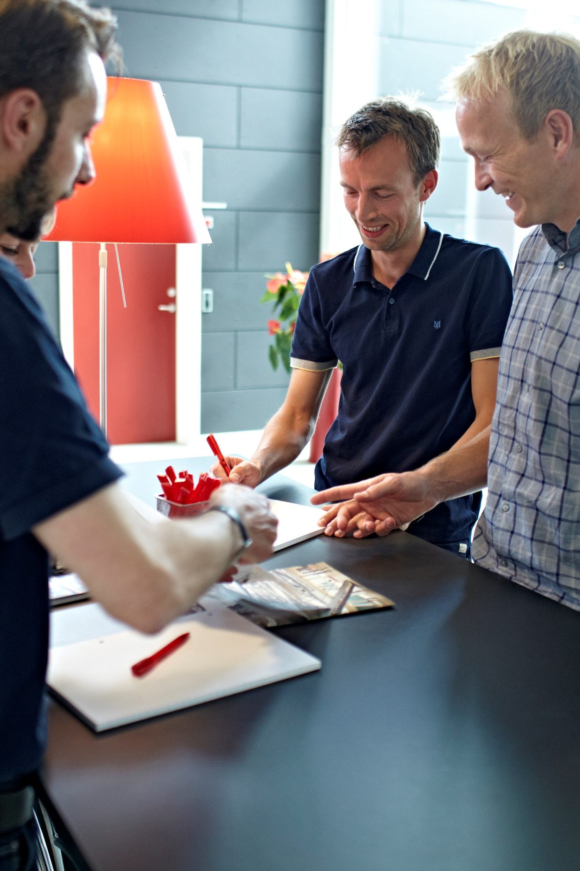
Networking
Presentations (general or in specific subjects) at conferences.
Actively attend exhibitions.
Increase cooperation and knowledge sharing between members so we know more about activities in each country.
Increase the numbers of members in CFPA Europe.
Ensure that our network is covet.
Regular contacts/meetings with important stakeholders working in the same fields.
12

Slide 13
Networking
Sign Memorandum of Understanding with organisations that can strengthen CFPA Europe and its members.
Change CFPA Europe’s statutes so it will be possible for countries outside European hemisphere to join CFPA Europe.
Change CFPA Europe’s statutes to make it possible to have organisation, company and individual ambassadors.
Check the 17 UN goals about sustainable cities and communities & climate action to find out the ones that are relevant in the context of fire safety, security and natural hazards.
13

Slide 14
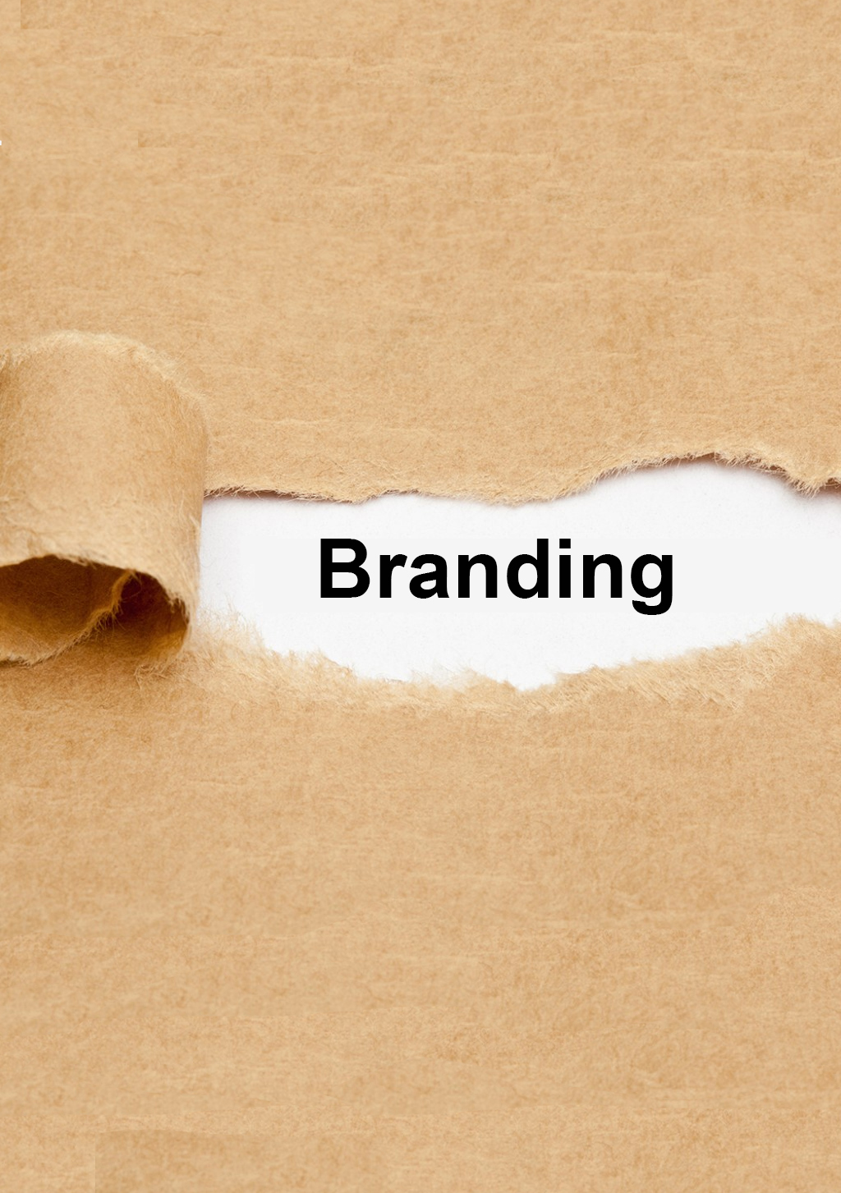
Networking
Continuously improve and develop Website and Newsletter.
Make a strategy on how to be active on social media and implement it.
Enhance the use of Guidelines by our members.
Independency is the base for all our work.
14

